Slide 1
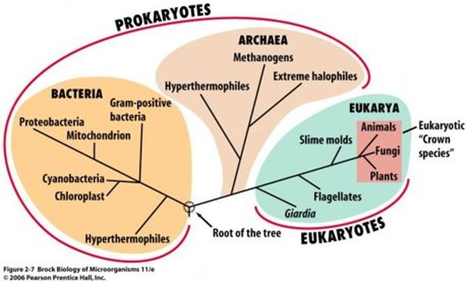
Scaling of metabolic rate with cell size in prokaryotes & phytoplankton
By Hira Tanvir
Notes:
Over the next 5 months I will be doing a meta analysis using the Global BioTraits data to find a relationship between the scalings of metabolic rate with cell size in prokaryotes and unicellular organisms such as phytoplanktons.

Slide 2
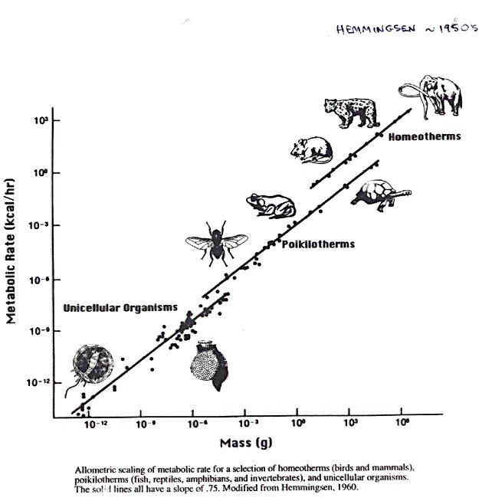
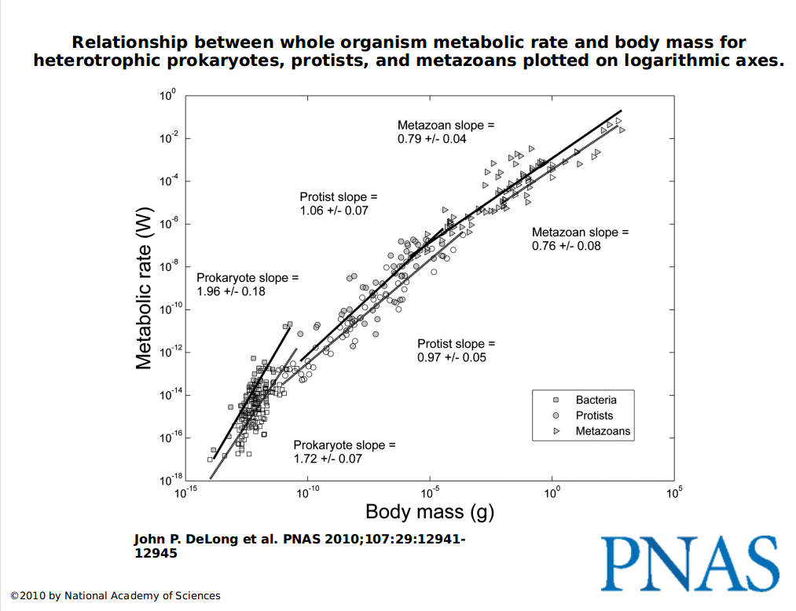
Why study these relationships?
Notes:
Well, if we understand how form or functions change as organisms get bigger or smaller, it is possible to learn something fundamental about the underlying processes or learn about what factors place evolutionary limits on organismal growth and adaptations.
There have been a number of studies that have investigated allometric relationship between body size and metabolic rate across several different taxa of animals and plants, and for different physiological states. In 1930's, Max Klieber demonstrated that the metabolic rate of birds and mammals scales as approximately three-quarters (3/4s) power of body mass. And several other studies supporting this power function led to the belief that a scaling exponent of three-quarters applies to all organisms. Many studies have since then proven that Kliebers law does not apply universally to all organisms. DeLong's paper from 2010 illustrates that there are potentially differences in scaling for different groups.
...However, few studies have examined the metabolic scaling relationships in unicellular prokaryotes and phytoplanktons with respect to cell size.
and as like a possible extension to the results later you might want to look not only at different taxonomic groups, but maybe also differences in scaling between functional groups (e.g. heterotrophic vs autotrophic bacteria/phytoplankton)

Slide 3
Aims of the Study
Explore
Explore the metabolic scaling relationship at different reference temperatures
Determine
Determine the scaling exponent for each group
Evaluate
Evaluate metabolic efficiency w.r.t cell size/volume
Notes:
Using empirical data from the Global Biotraits dataset, I aim to explore the metabolic scaling relationship for the two major groups of prokaryotes which are Bacteria and Archaea and I will also look at the metabolic scaling across unicellular species of phytoplankton.
As temperature impacts the size of cells, I will be looking at how the metabolic rate scales with cell size at three reference temperatures.

Slide 4
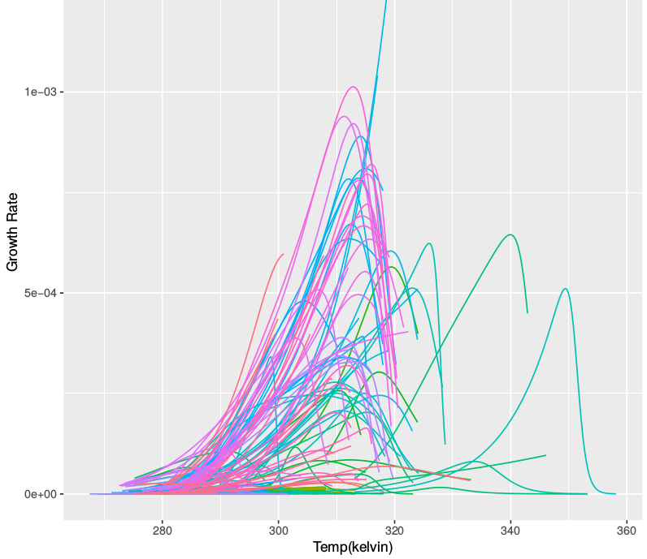
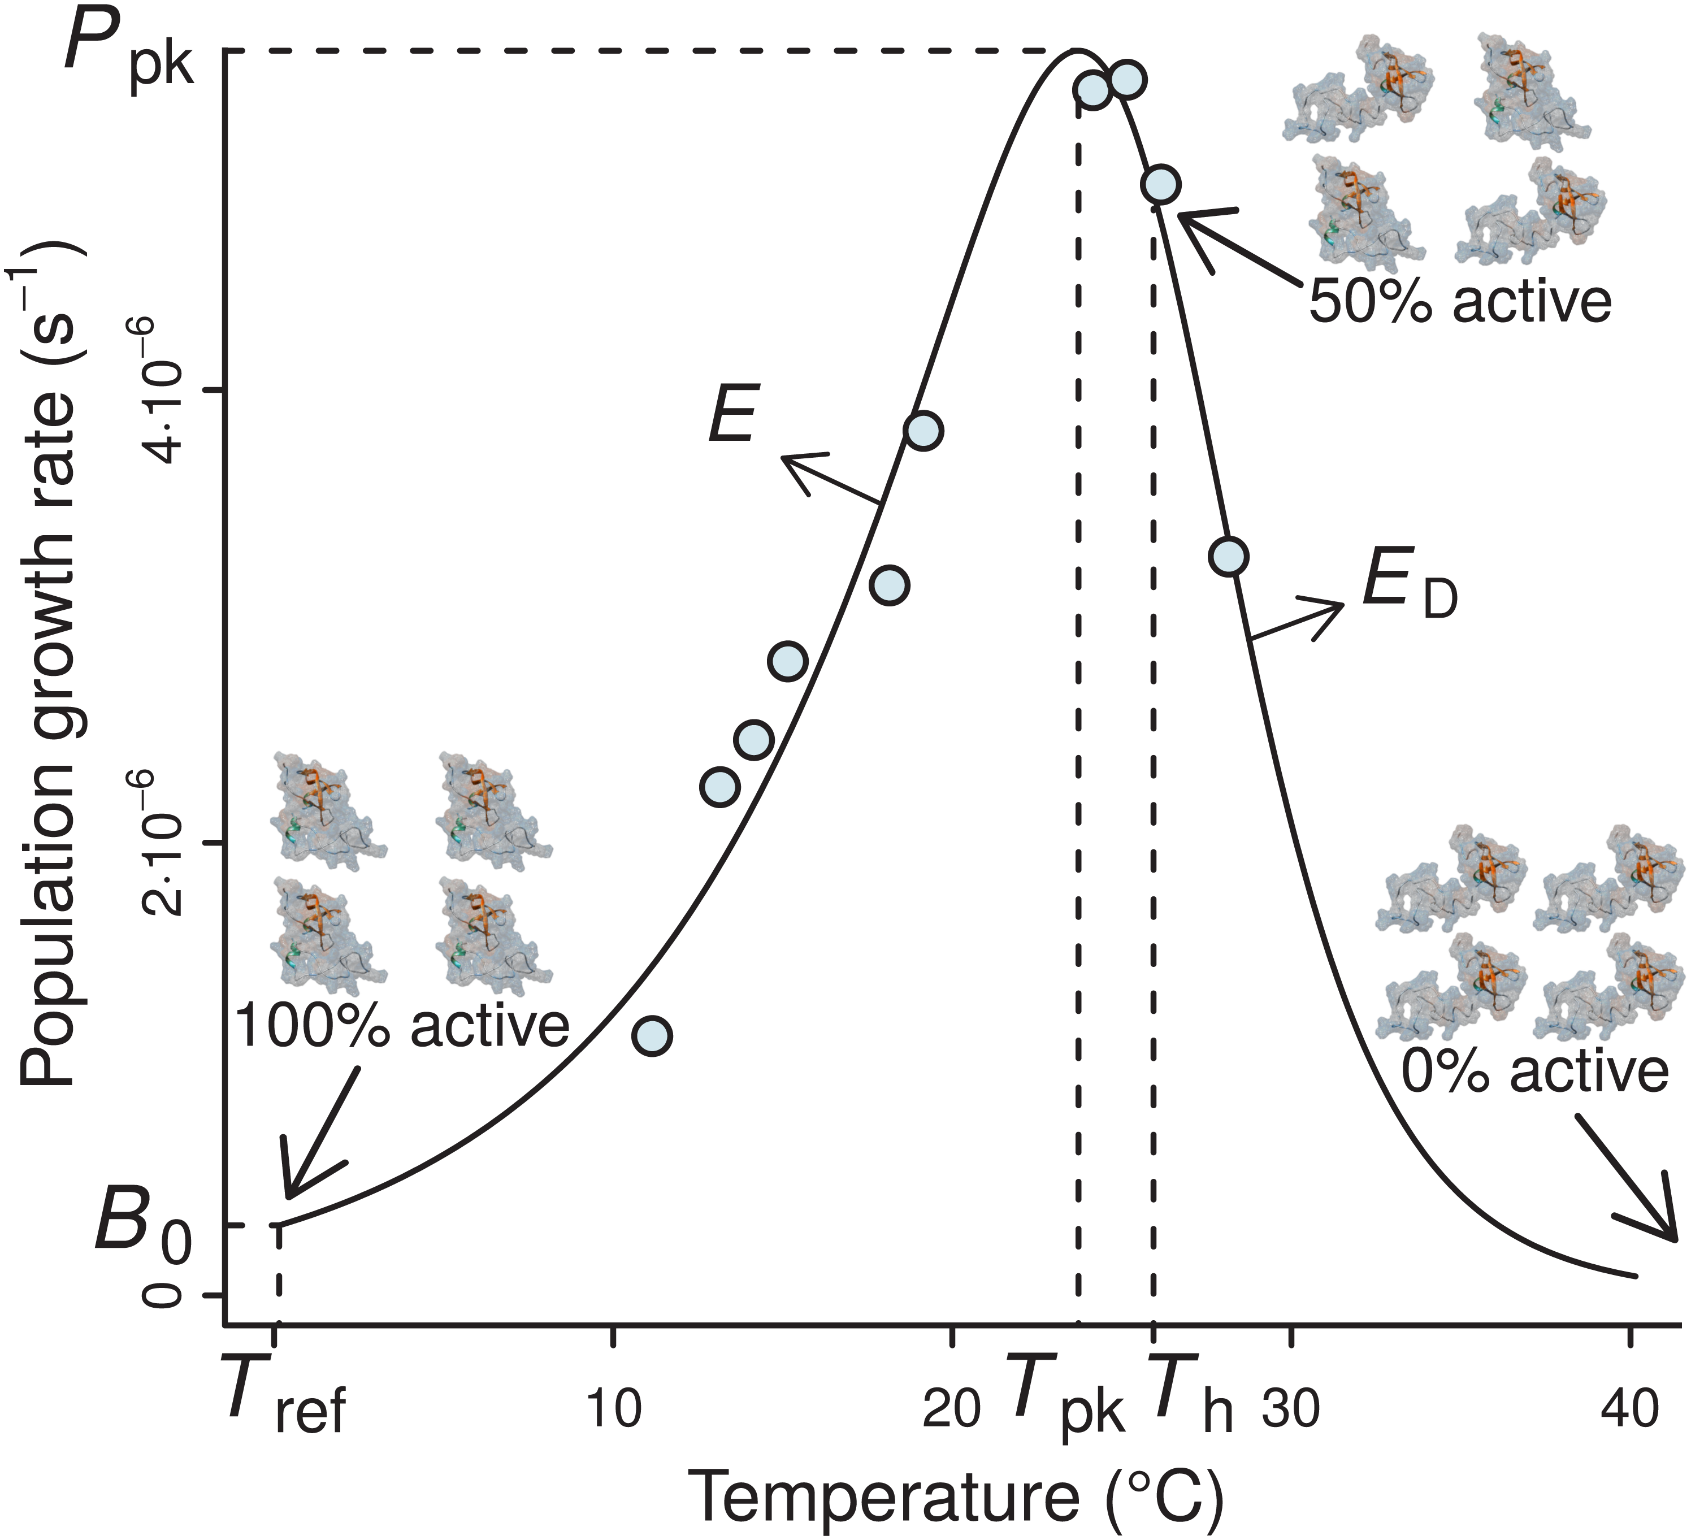
General outline of analyses
Fit empirical data to Sharpe-Schoolfied model using non-linear least squares method.
Plot the thermal performance curves .
Obtain reference temperatures by estimating average optimal temperatures (Tpk)
Find size information through literature search
Plot growth rate with size
Using power function, describe scaling relationship & determine scaling exponent.
A typical example of the four-parameter Sharpe-Schoolfield model fitted to a thermal performance curve of Prochlorococcus marinus strain MIT9515 (Johnson et al., 2006).
Notes:
- Using the necessary empirical data from the Global BioTraits dataset, I will analyse metabolic scaling trends across major phylogenetic groups of Bacteria, Archaea and Phytoplankton as size increases.
- First thing I'm going to do is fit the data to the sharpe-schoolfield model using the non-linear least squares technique, extract the data that converged and plot the curves on the same graph to visualize how metabolic/growth rate scales as temperature increases across species of bacteria, archaea and phytoplankton. You would expect to see a unimodal curve which is slightly skewed to the right, the peak of the curve, referred to as T-peak is temperature at optimal trait performance. By looking at the T-peaks of each curve, you would expect to see the increase in growth rate with temperature.
- I can also visualise trends by plotting logged data and calculate rates as temperature increases.
- I will need to find size information for prokaryotes by doing an online literature search
- Once I have that I will visualise the relationship between growth rate as size increases
- I will use the power function to evaluate the scaline exponent for prokaryotes, archaea and phytoplankton.

Slide 5
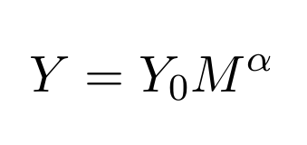
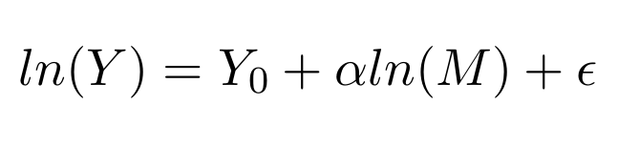
The Power Function
Notes:
This is the power function:
Where Y is the metabolic rate (i.e. growth rate), Y0 is the normalisation constant and α is the scaling exponent and M is the body mass or cell size in this case. This relationship can be shown linearly by log-transforming the equation to give: (point at second equation)
Where Y 0 is the intercept, α is the gradient of the slope and epsilon is the error term.

